Slide 1
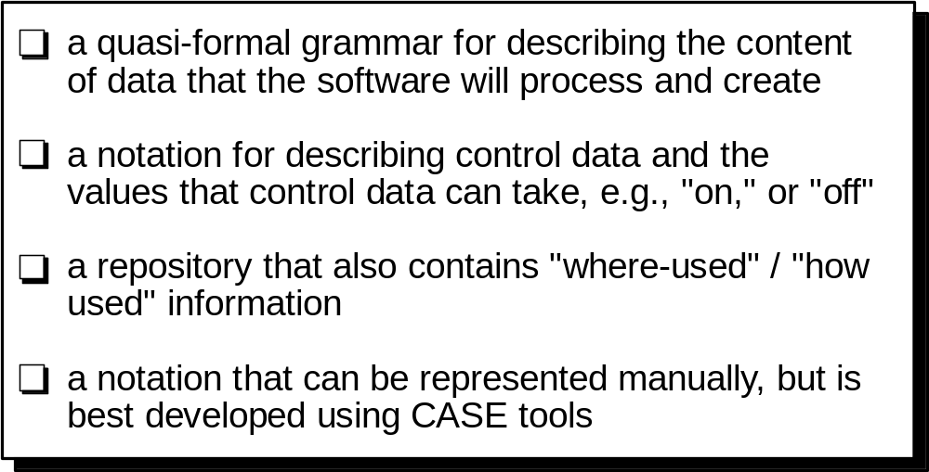
The Data Dictionary

Slide 2
Building a Data Dictionary
Name:
the primary name of the composite data item
Aliases:
other names for the data item
Where used:
data transforms (processes) that use the
composite data item
How used:
the role of the data item (input, output,
temporary storage, etc.)
Description:
a notation for representing content (presented
on next slide)
Format:
specific information about data types, pre-set
values (if known)

Slide 3
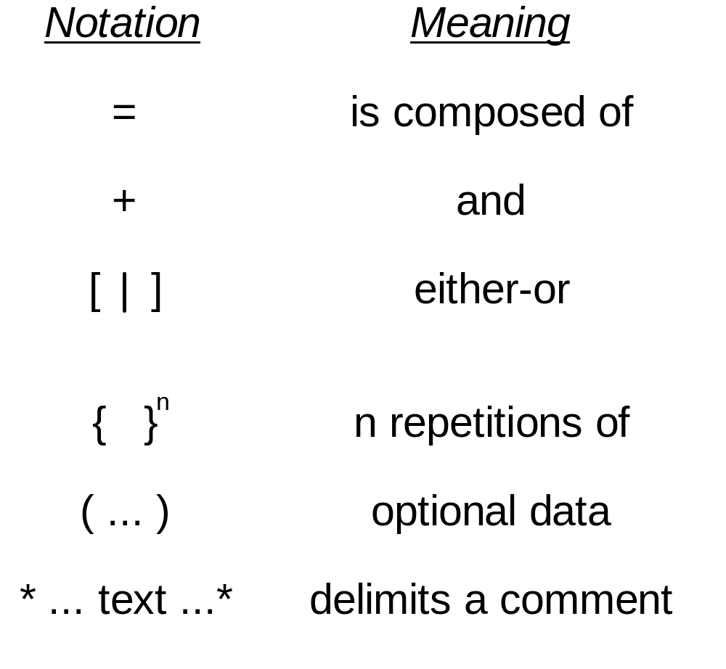
Data Dictionary Notation

Slide 4
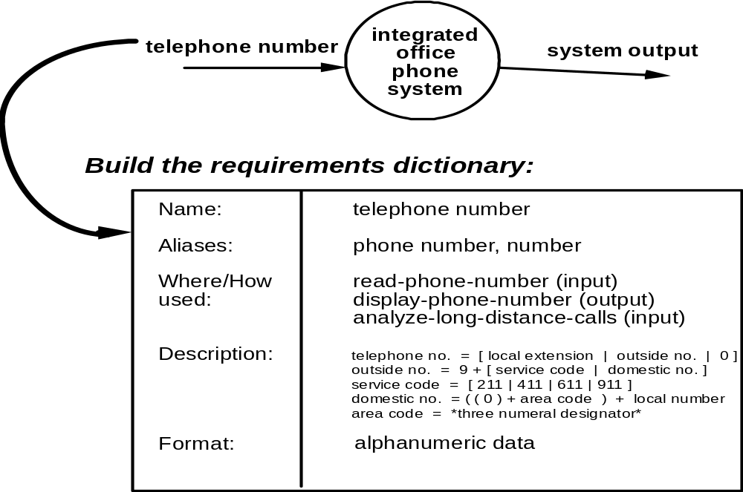
Data Dictionary Example

